Slide 1
SALARY PREDICTIONS OF DATA PROFESSIONS
PRESENTED BY
OLABUNTU, BABATUNDE AFEEZ

Slide 2
INTRODUCTON
Salary Prediction is a vital aspect of modern workforce management, bridging the gap between employers expectations and employees expectation
Accurate Salary prediction plays a major role Organization success
This presentation talks about Machine learning model built for predicting the salaries of Data Professionals

Slide 3
DATASET
Before Cleaning
After cleaning
2639
2470
Dataset was split into:
Categorical Columns: ['FIRST NAME', 'LAST NAME', 'SEX', 'DESIGNATION', 'UNIT']
Numerical Columns: ['AGE', 'SALARY', 'LEAVES USED', 'LEAVES REMAINING', 'RATINGS', 'PAST EXP']
Date/time Columns: ['DOJ', 'CURRENT DATE']

Slide 4
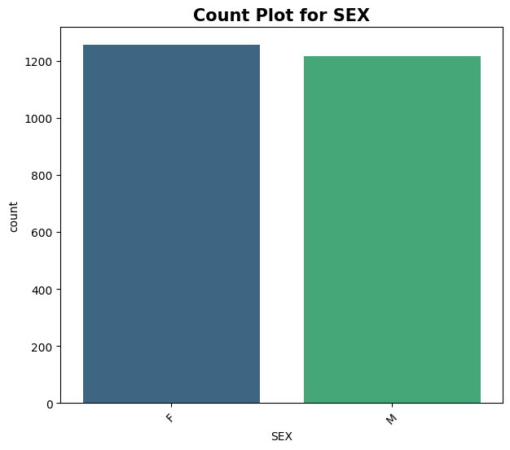
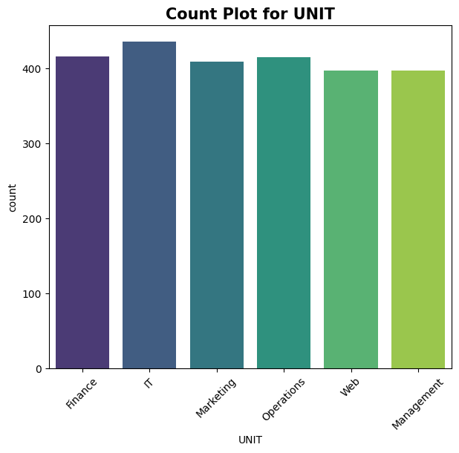
Figure 1: The amount of each SEX and UNIT found in the Dataset

Slide 5
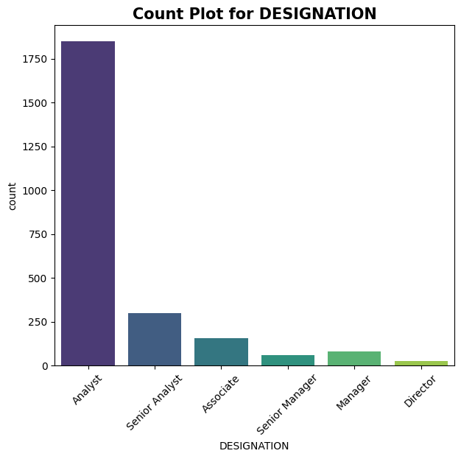
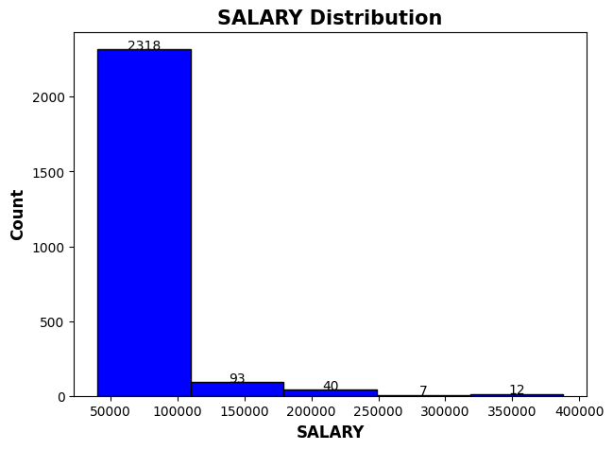
Figure 2: The amount of each Designation in the Dataset and the distribution of the Salary

Slide 6
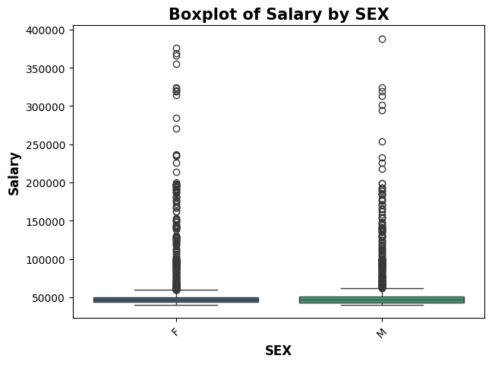
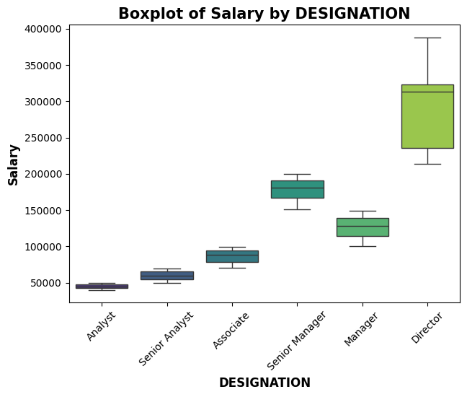
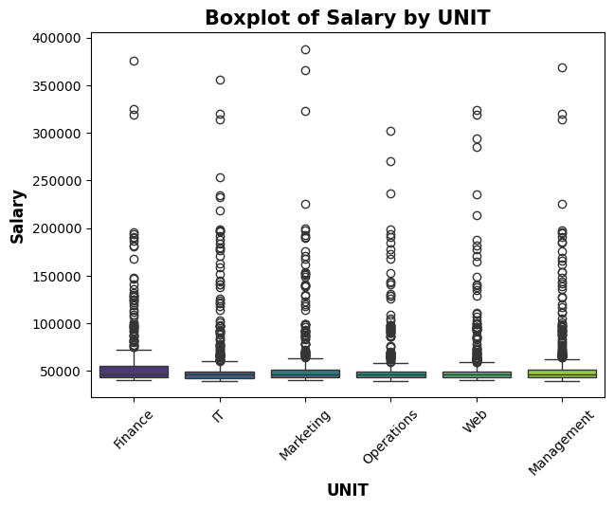
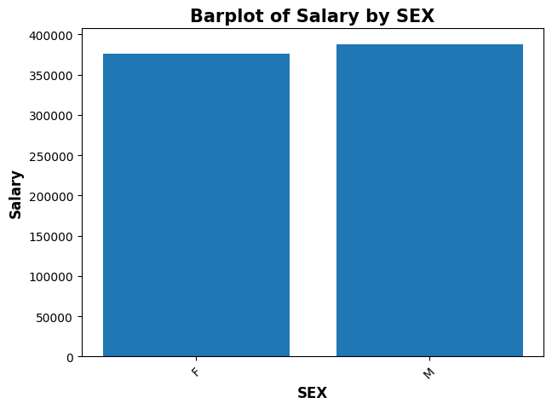
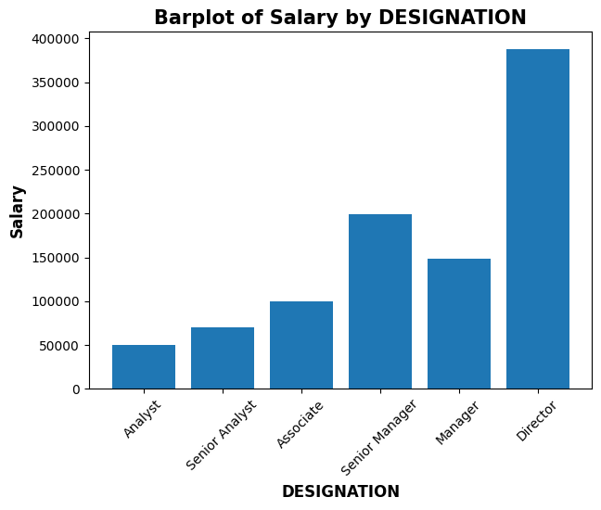
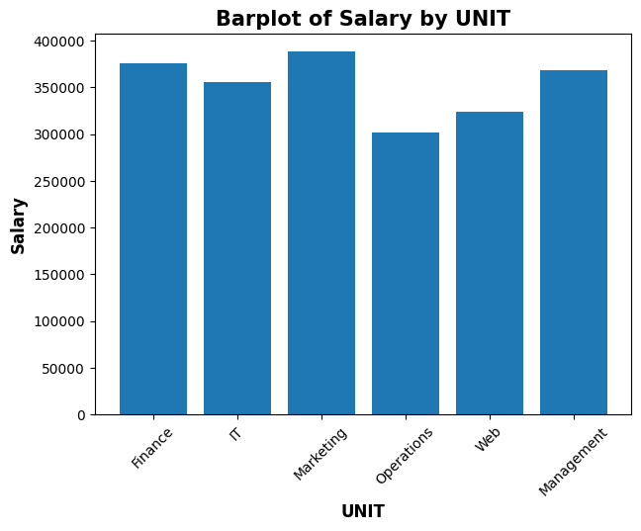
Figure 4: The relationship between SEX, DESIGNATION, UNIT and SALARY

Slide 7
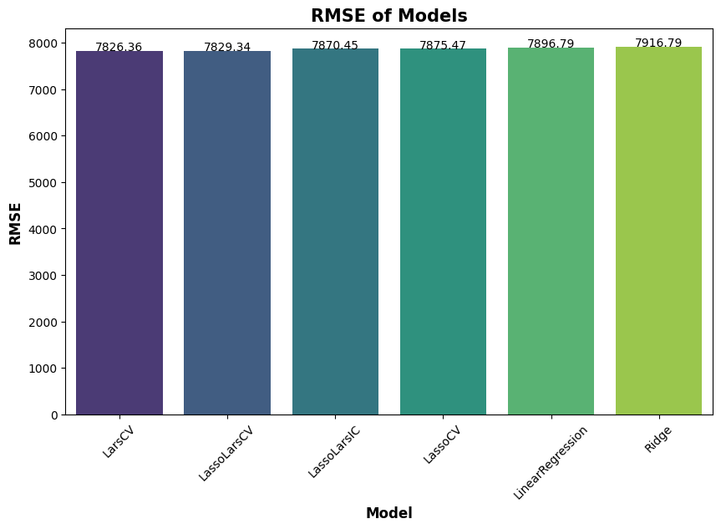


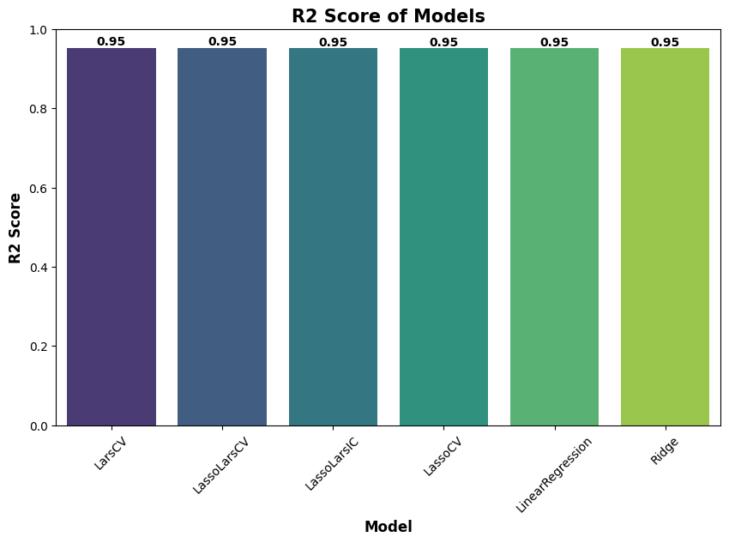
Figure 5: The evaluation result of the 6 top models among the 42 trained

Slide 8
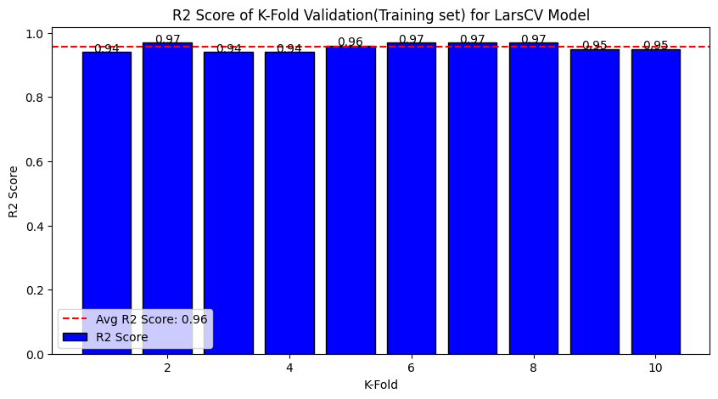
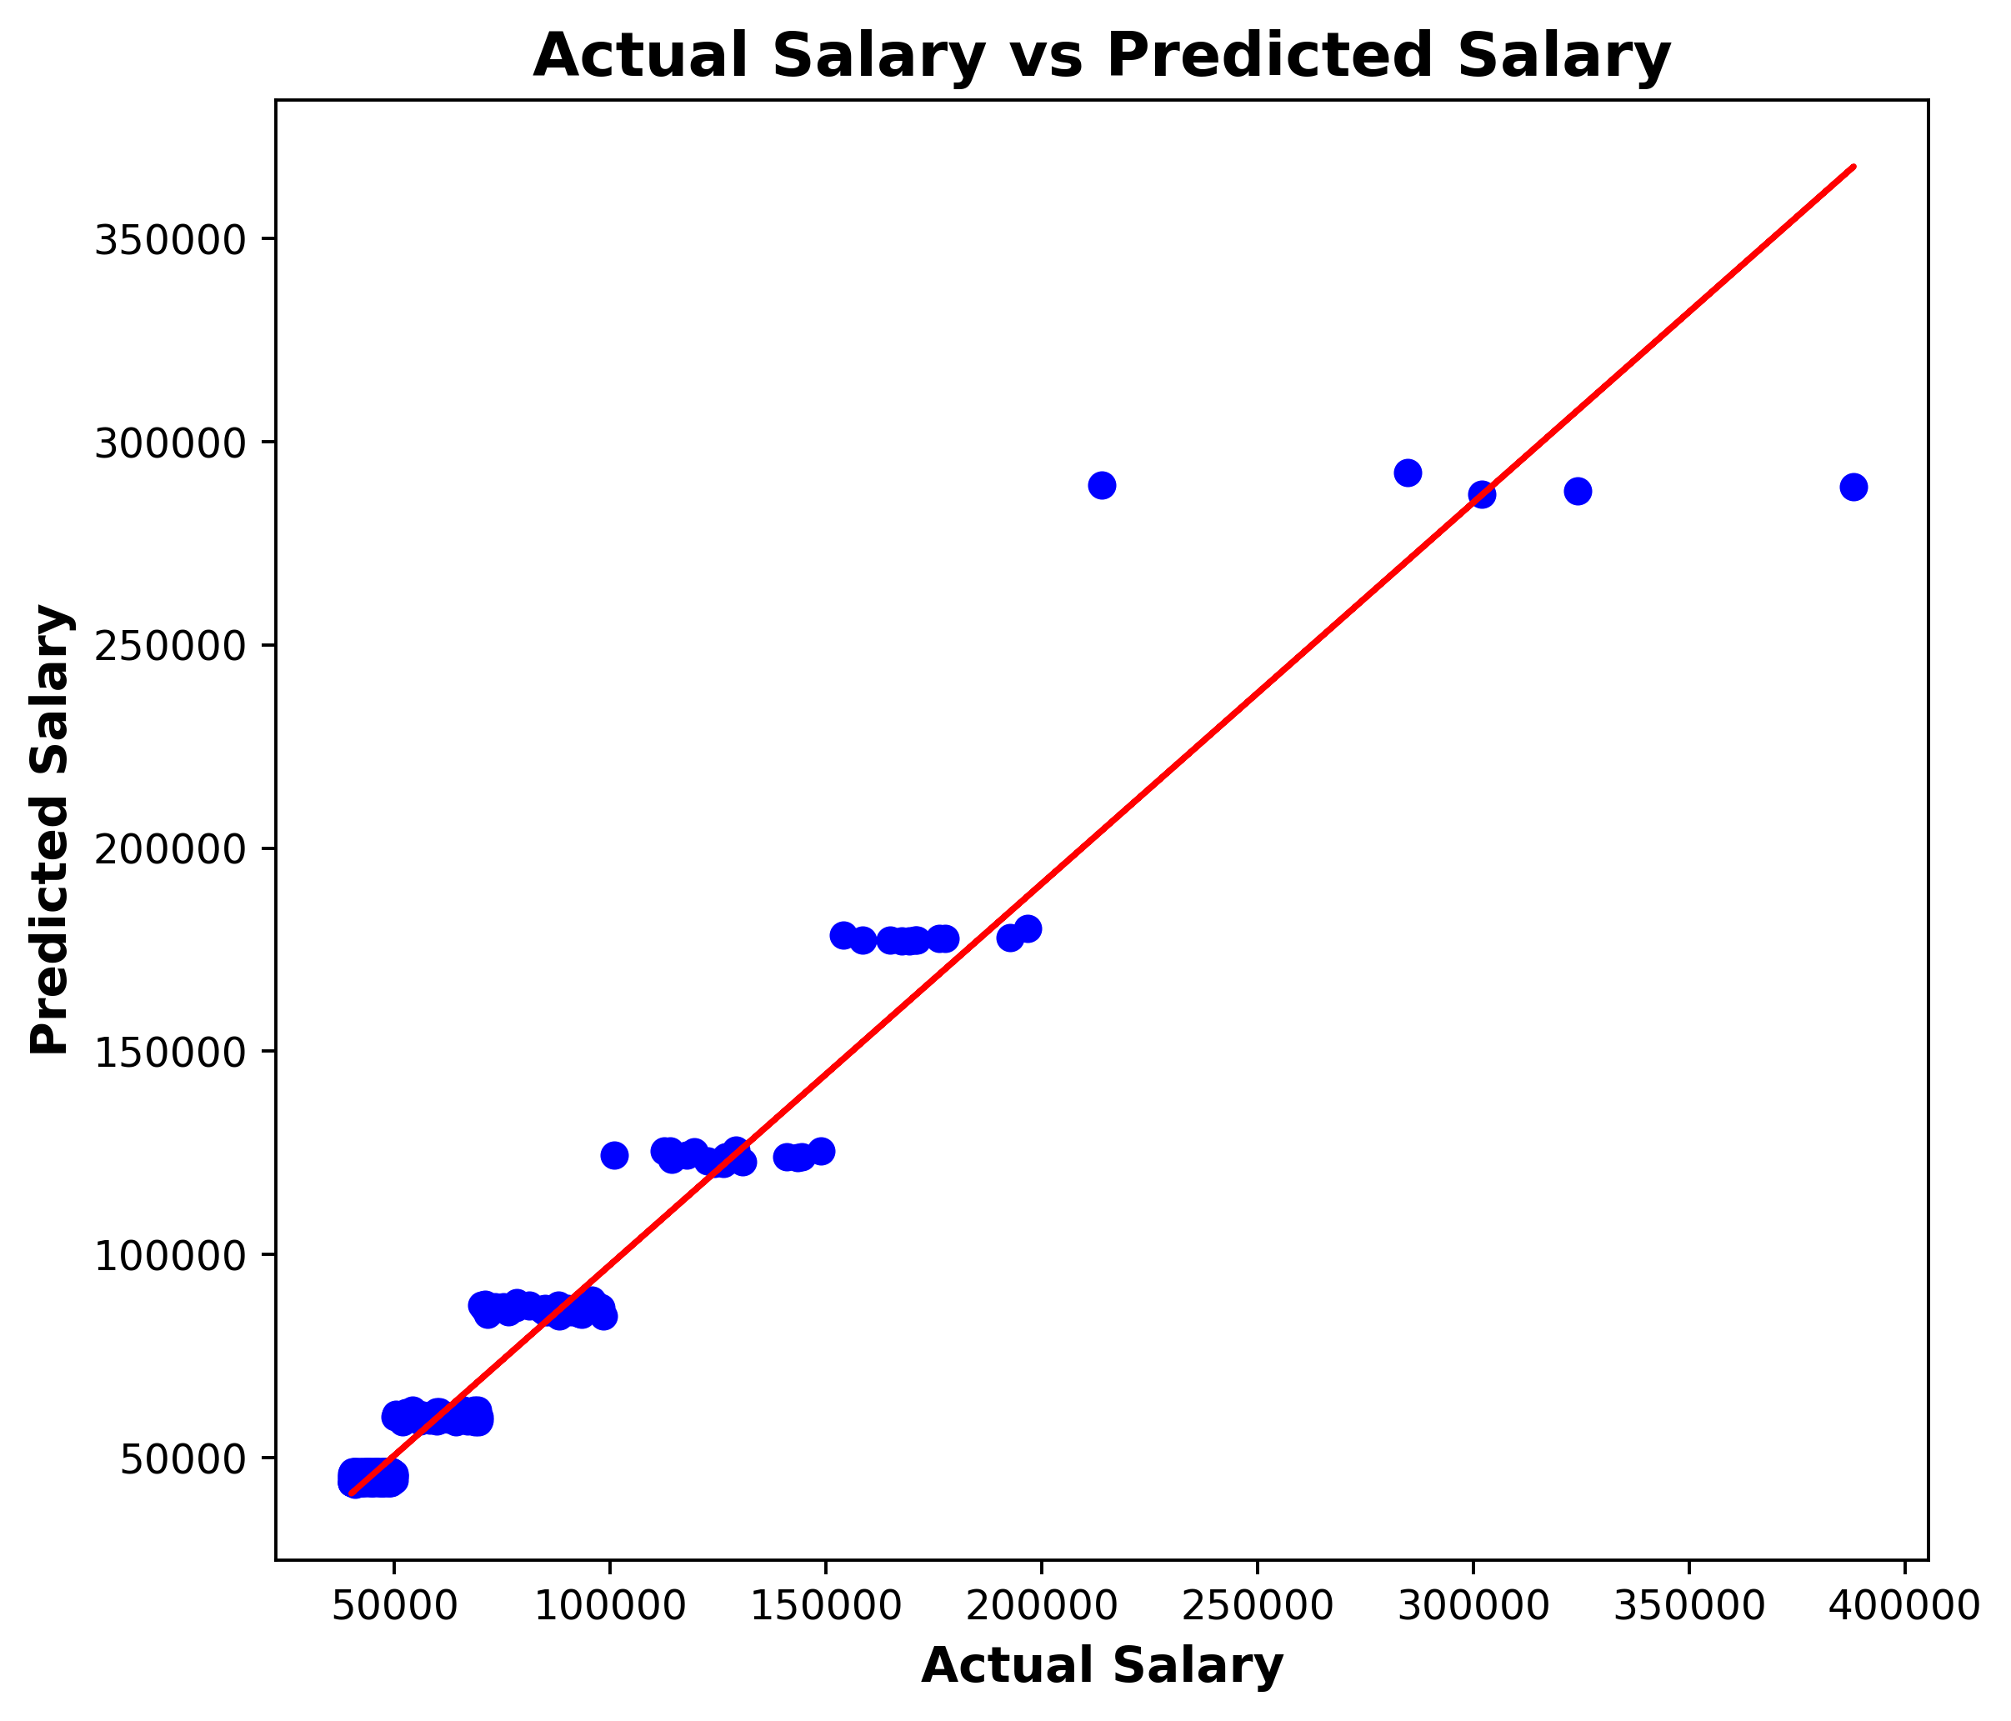
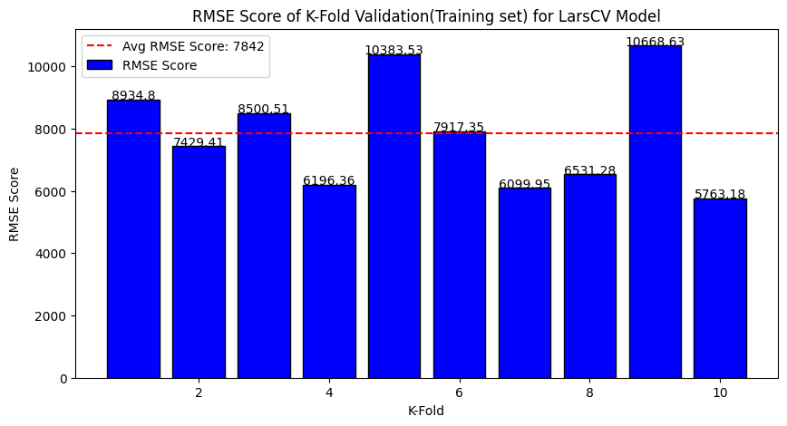
Figure 6: The result of cross validation on Training set and the predicted vs actual result

Slide 9
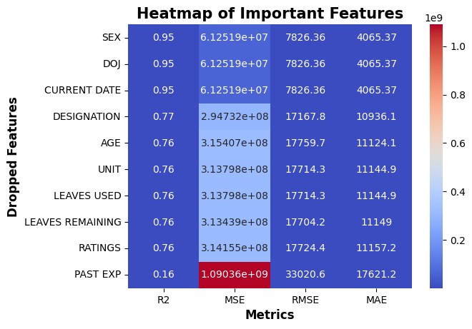
FINDINGS AND RECOMMENDATION
I found out that MALES , DIRECTORS and MARKETING unit are been paid the highest Salary
I found out that FEMALES, ANALYST and OPERATIONS unit are been paid the lowest Salary
42 model were tried out and among the top 10 Larscv was the best having a R2 of 0.95, RMSE of 7826, MAE of 4064 and MSE of 61247978
I found out that features like SEX,DOJ and CURRENT DATE as no effect on the model while feature like DESIGNATION,AGE,UNIT,LEAVES USED,LEAVE REMAINING and RATINGS as effect on the Model, but PAST EXPERIENCE as a great effect on the Model
I Recommend that when collecting data features like SEX,DOJ and CURRENT DATE be omitted since they have no effect on the Model. However, features like DESIGNATION , AGE,UNIT,LEAVES USED,LEAVE REMAINING and RATINGS especially PAST EXPERIENCE must be collected
Figure 7: The importance of each feature on the model

